Slide 1
Fitting and Alignment
CS696: Computer Vision
Xiaobai Liu
Szeliski 6.1
Acknowledgment: Many slides from Derek Hoiem and Grauman&Leibe 2008 AAAI Tutorial

Slide 2
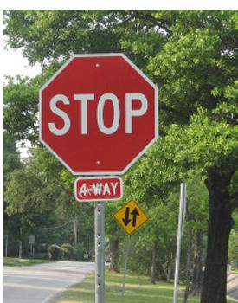
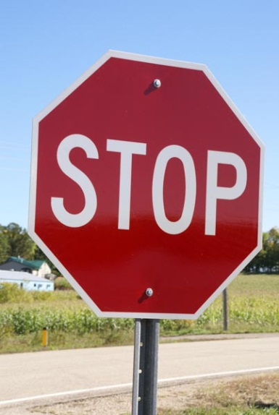
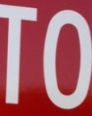
This section: correspondence and alignment
Correspondence: matching points, patches, edges, or regions across images
≈

Slide 3




Overview of Keypoint Matching
1. Find a set of distinctive key- points
A₁
B₃
2. Define a region around each keypoint
A₂
A₃
B₁
B₂
3. Extract and normalize the region content
4. Compute a local descriptor from the normalized region
5. Match local descriptors

Slide 4
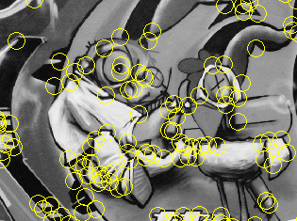
Review: Interest points
Keypoint detection: repeatable and distinctive
Corners, blobs, stable regions
Harris, DoG, MSER

Slide 5
Review: Choosing an interest point detector
What do you want it for?
Precise localization in x-y: Harris
Good localization in scale: Difference of Gaussian
Flexible region shape: MSER
Best choice often application dependent
Harris-/Hessian-Laplace/DoG work well for many natural categories
MSER works well for buildings and printed things
Why choose?
Get more points with more detectors
There have been extensive evaluations/comparisons
[Mikolajczyk et al., IJCV’05, PAMI’05]
All detectors/descriptors shown here work well

Slide 6
Review: Local Descriptors
Most features can be thought of as templates, histograms (counts), or combinations
The ideal descriptor should be
Robust and Distinctive
Compact and Efficient
Most available descriptors focus on edge/gradient information
Capture texture information
Color rarely used

Slide 7
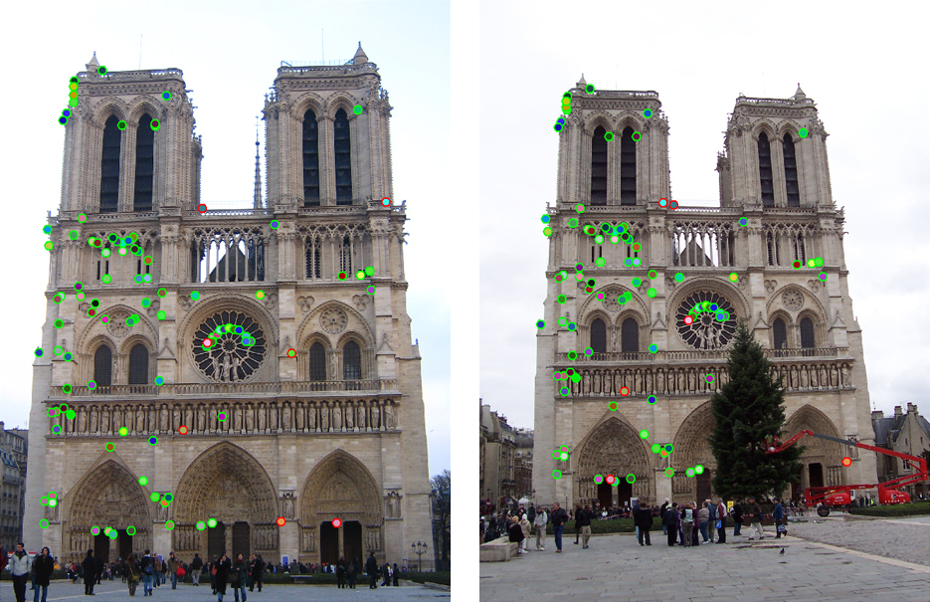
How do we decide which features match?

Slide 8
Feature Matching
Szeliski 4.1.3
Simple feature-space methods
Evaluation methods
Acceleration methods
Geometric verification (Chapter 6)

Slide 9
Feature Matching
Simple criteria: One feature matches to another if those features are nearest neighbors and their distance is below some threshold.
Problems:
Threshold is difficult to set
Non-distinctive features could have lots of close matches, only one of which is correct

Slide 10
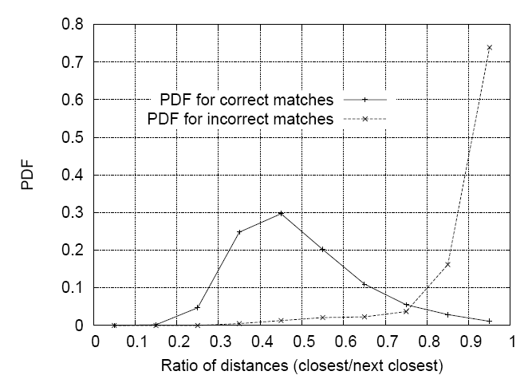
Matching Local Features
Threshold based on the ratio of 1st nearest neighbor to 2nd nearest neighbor distance.
Lowe IJCV 2004

Slide 11
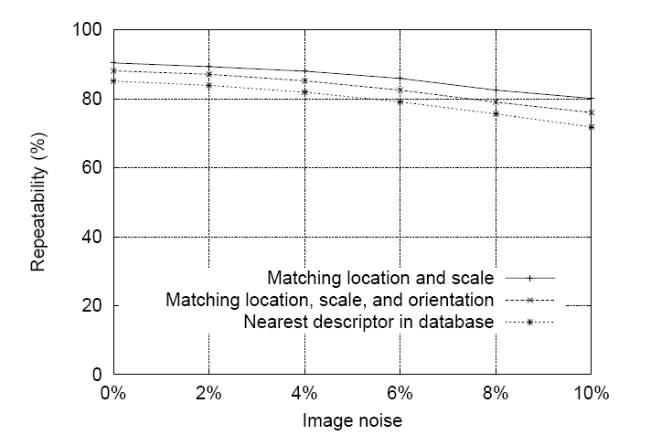
SIFT Repeatability
Lowe IJCV 2004

Slide 12
SIFT Repeatability

Slide 13
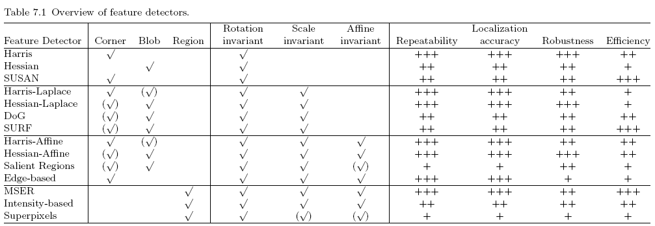
Comparison of Keypoint Detectors
Tuytelaars Mikolajczyk 2008

Slide 14
How do we fit the best alignment?

Slide 15
Today’s Outline
Formulation
Solution

Slide 16
Alignment
Alignment: find parameters of model that maps one set of points to another
Typically want to solve for a global transformation that accounts for *most* true correspondences
Difficulties
Noise (typically 1-3 pixels)
Outliers (often 50%)
Many-to-one matches or multiple objects

Slide 17

Start with a simple case: translation
A₁
A₂
A₃
B₁
B₂
B₃
Given matched points in {A} and {B}, estimate the translation of the object
Function of point A

Slide 18
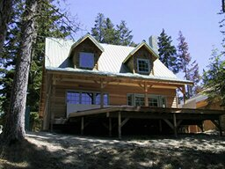
Parametric (global) warping
T
p = (x,y)
p’ = (x’,y’)
Transformation T is a coordinate-changing function:
p’ = T(p)
What does it mean that T is global?
Is the same for any point p
can be described by just a few numbers (parameters)
For linear transformations, we can represent T as a matrix
p’ = Tp

Slide 19
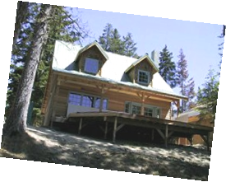
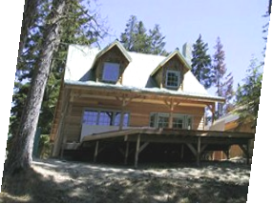
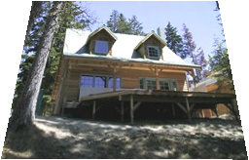
Common transformations
original
Transformed
translation
rotation
aspect
affine
perspective
Slide credit (next few slides): A. Efros and/or S. Seitz

Slide 20
Scaling
Scaling a coordinate means multiplying each of its components by a scalar
Uniform scaling means this scalar is the same for all components:
× 2

Slide 21
Scaling
Non-uniform scaling: different scalars per component:
X × 2, Y × 0.5

Slide 22
Scaling
Scaling operation:
Or, in matrix form:
scaling matrix S

Slide 23
2-D Rotation
(x’, y’)
(x, y)
x’ = x cos(θ) - y sin(θ)
y’ = x sin(θ) + y cos(θ)
θ

Slide 24
2-D Rotation
Polar coordinates…
x = r cos (φ)
y = r sin (φ)
x’ = r cos (φ + θ)
y’ = r sin (φ + θ)
Trig Identity…
x’ = r cos(φ) cos(θ) – r sin(φ) sin(θ)
y’ = r sin(φ) cos(θ) + r cos(φ) sin(θ)
Substitute…
x’ = x cos(θ) - y sin(θ)
y’ = x sin(θ) + y cos(θ)
(x’, y’)
(x, y)
θ
φ

Slide 25
2-D Rotation
This is easy to capture in matrix form:
Even though sin(θ) and cos(θ) are nonlinear functions of θ,
x’ is a linear combination of x and y
y’ is a linear combination of x and y
What is the inverse transformation?
Rotation by –θ
For rotation matrices
R

Slide 26
Basic 2D transformations
Scale
Shear
Rotate
Translate
Affine is any combination of translation, scale, rotation, shear
Affine

Slide 27
Affine Transformations
Affine transformations are combinations of
Linear transformations, and
Translations
Properties of affine transformations:
Lines map to lines
Parallel lines remain parallel
Ratios are preserved
Closed under composition
or
Notes:
Ratios of distances along straight lines are preserved

Slide 28
Projective Transformations
Projective transformations are combos of
Affine transformations, and
Projective warps
Properties of projective transformations:
Lines map to lines
Parallel lines do not necessarily remain parallel
Ratios are not preserved
Closed under composition
Models change of basis
Projective matrix is defined up to a scale (8 DOF)

Slide 29
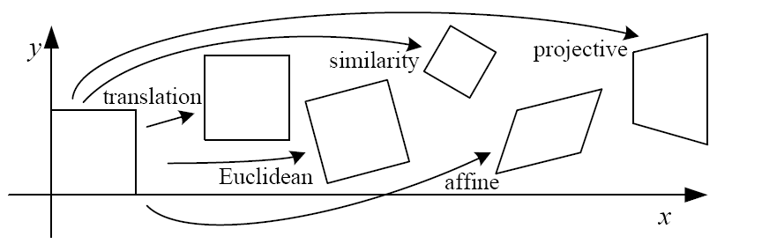
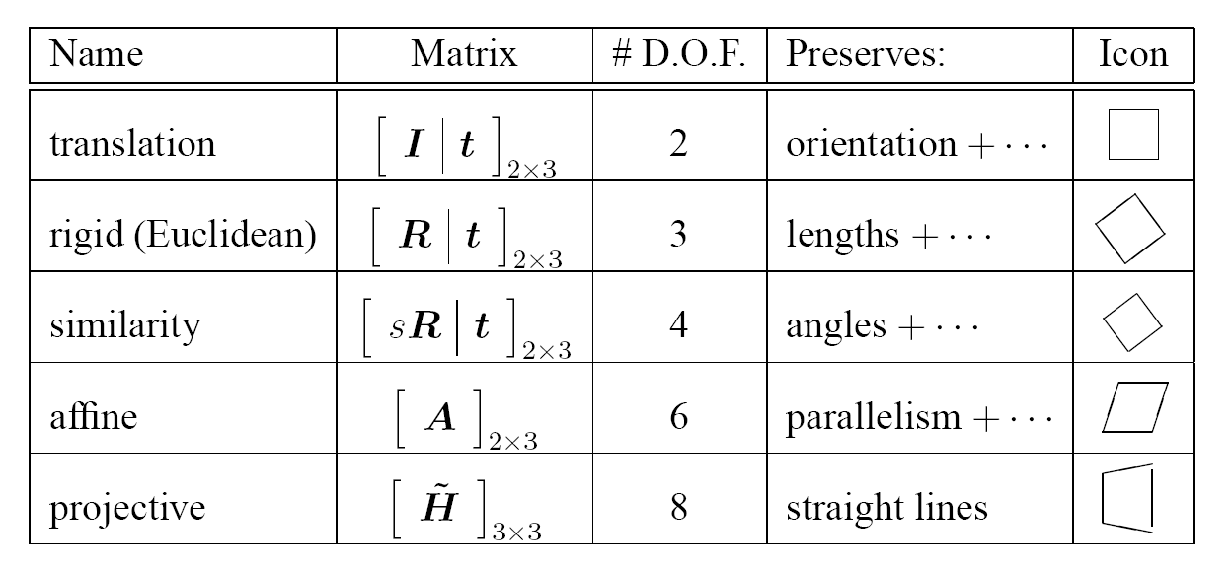
2D image transformations (reference table)
Szeliski 2.1

Slide 30
Today’s Outline
Formulation
Solution

Slide 31
Example: solving for translation
A₁
B₁
Given a pair of matching points, estimate the translation of the object

Slide 32
Example: solving for translation
A₁
A₅
B₄
A₂
A₃
(t_{x}, t_{y})
B₁
A₄
B₂
B₃
B₅
Given 5 pairs of matching points, each with noises, how?

Slide 33
Fitting and Alignment: Methods
Global optimization / Search for parameters
Least squares fit
Robust least squares
Iterative closest point (ICP)
Hypothesize and test
Hough transform
RANSAC

Slide 34
Example: solving for translation
A₁
A₂
A₃
(t_{x}, t_{y})
B₁
B₂
B₃
Least square solution
Write in form Ax=b
Solve x
Notes:
Write down objective function
Derived solution
Compute derivative
Compute solution
Solve using pseudo-inverse or eigenvalue decomposition

Slide 35
Example: solving for translation
B₄
A₁
B₅
B₆
A₂
A₃
(t_{x}, t_{y})
B₁
A₄
B₂
B₃
A₅
A₆
Problem: outliers, multiple objects, and/or many-to-one matches
Hough transform solution
Initialize a grid of parameter values
Each matched pair casts a vote for consistent values
Find the parameters with the most votes
Solve using least squares with inliers

Slide 36
RANSAC
Robust fitting can deal with a few outliers – what if we have very many?
Random sample consensus (RANSAC): Very general framework for model fitting in the presence of outliers
Outline
Choose a small subset of points uniformly at random
Fit a model to that subset
Find all remaining points that are “close” to the model and reject the rest as outliers
Do this many times and choose the best model
M. A. Fischler, R. C. Bolles. Random Sample Consensus: A Paradigm for Model Fitting with Applications to Image Analysis and Automated Cartography. Comm. of the ACM, Vol 24, pp 381-395, 1981.
Notes:
This algorithm contains concepts that are hugely useful; in my experience, everyone with some
experience of applied problems who doesn’t yet know RANSAC is almost immediately able to use it to simplify some problem they’ve seen.

Slide 37
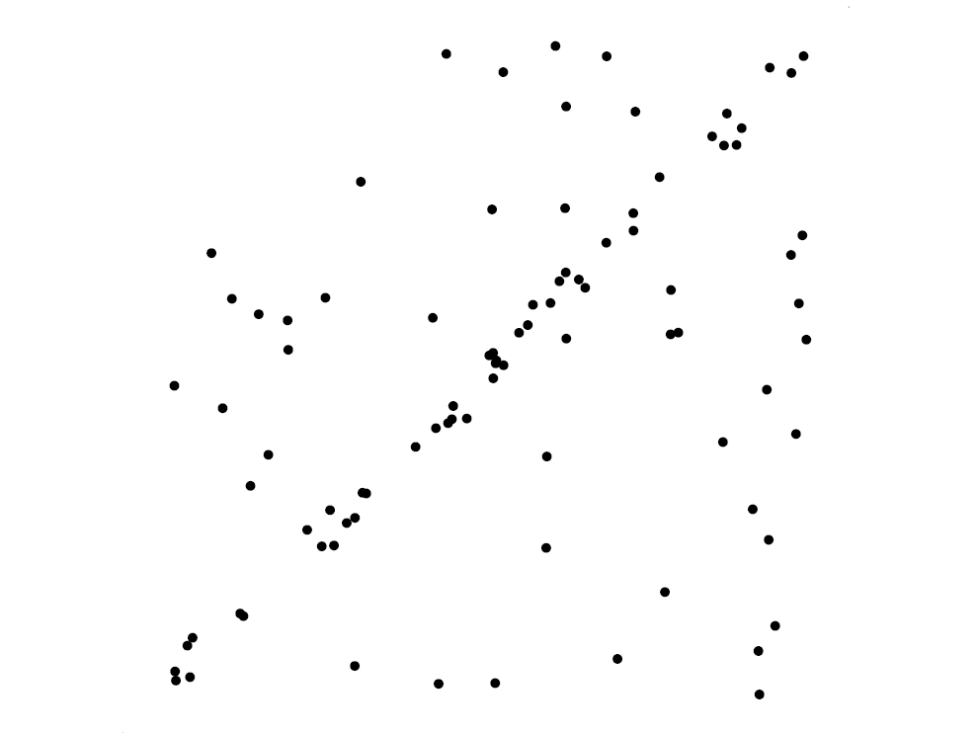
RANSAC for line fitting example
Source: R. Raguram

Slide 38
RANSAC for line fitting example
Least-squares fit
Source: R. Raguram

Slide 39
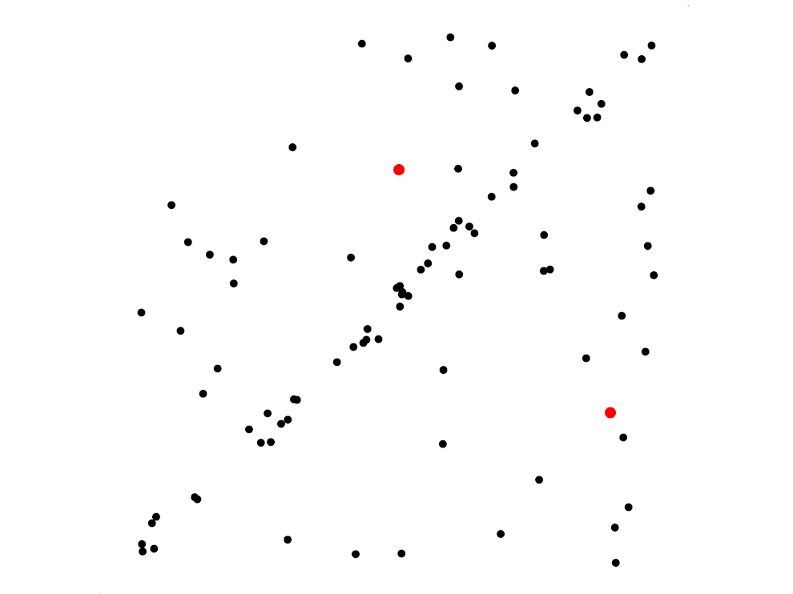
RANSAC for line fitting example
Randomly select minimal subset of points
Source: R. Raguram

Slide 40
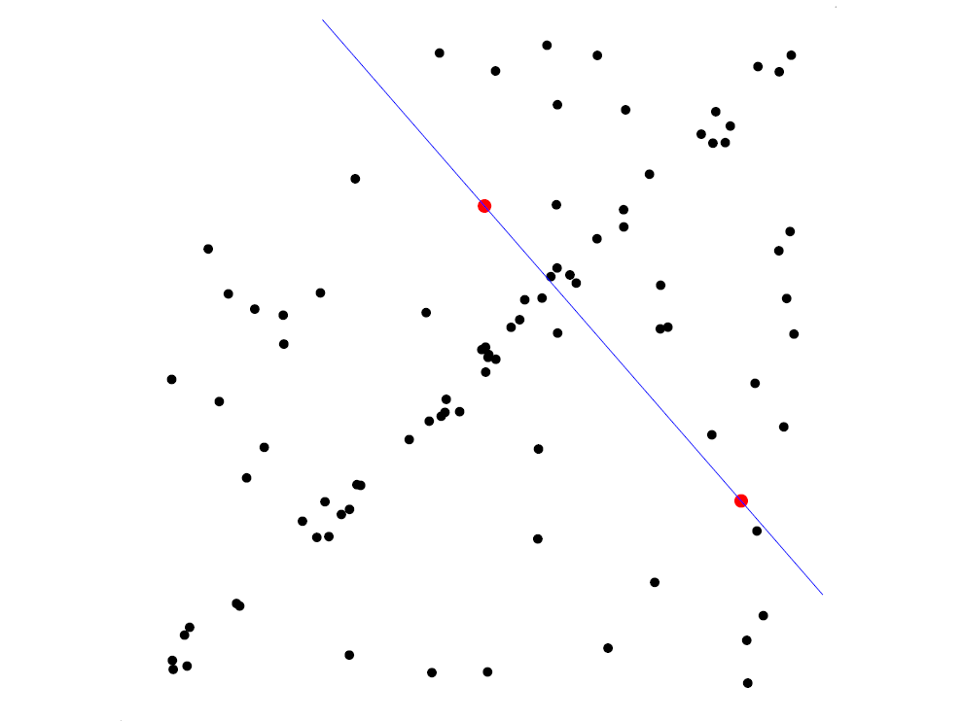
RANSAC for line fitting example
Randomly select minimal subset of points
Hypothesize a model
Source: R. Raguram

Slide 41
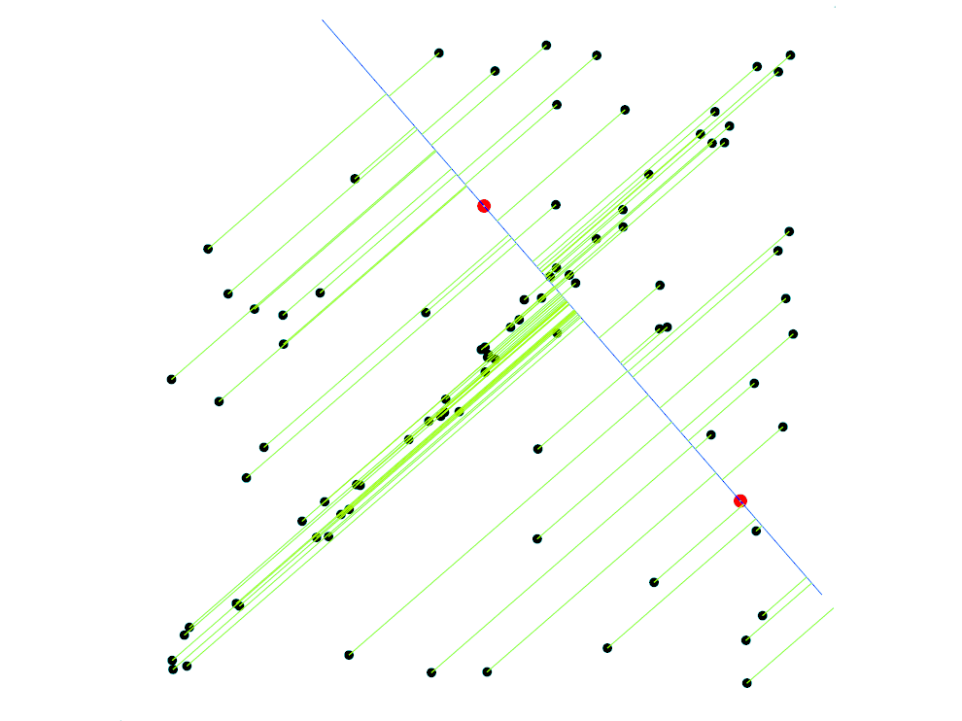
RANSAC for line fitting example
Randomly select minimal subset of points
Hypothesize a model
Compute error function
Source: R. Raguram

Slide 42
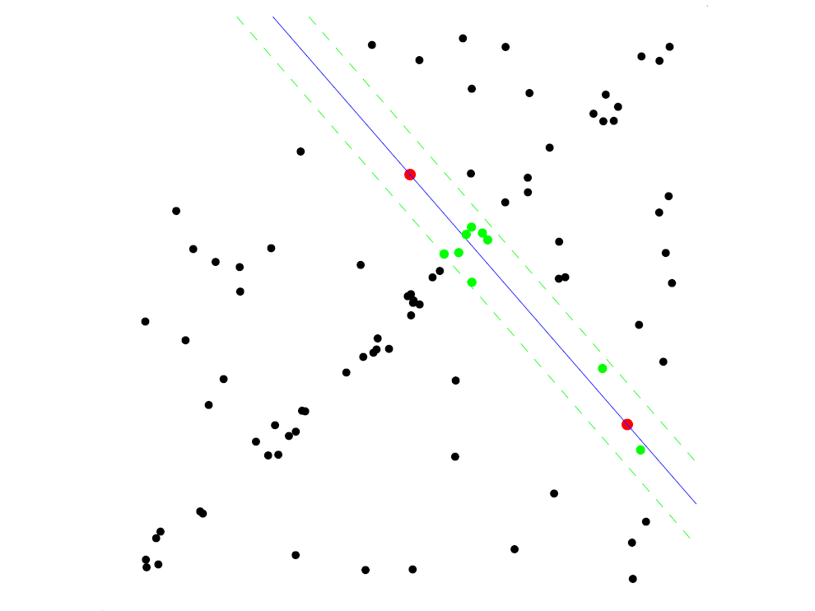
RANSAC for line fitting example
Randomly select minimal subset of points
Hypothesize a model
Compute error function
Select points consistent with model
Source: R. Raguram

Slide 43
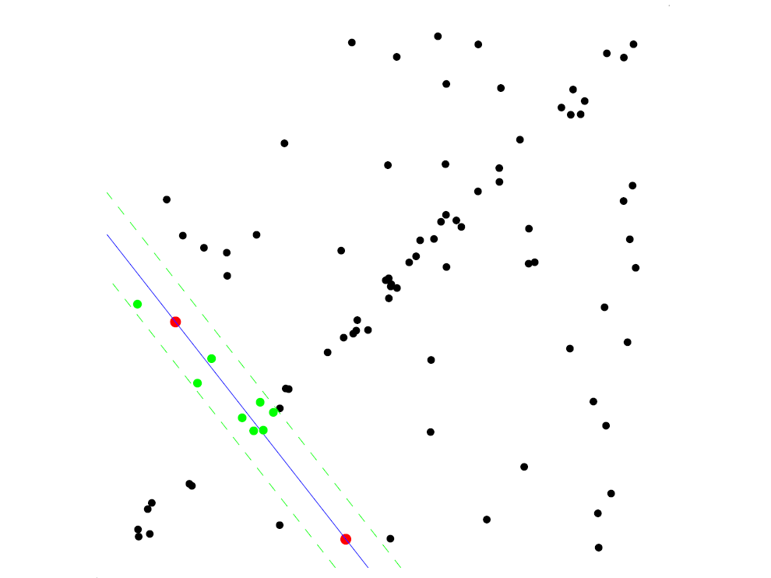
RANSAC for line fitting example
Randomly select minimal subset of points
Hypothesize a model
Compute error function
Select points consistent with model
Repeat hypothesize-and-verify loop
Source: R. Raguram

Slide 44
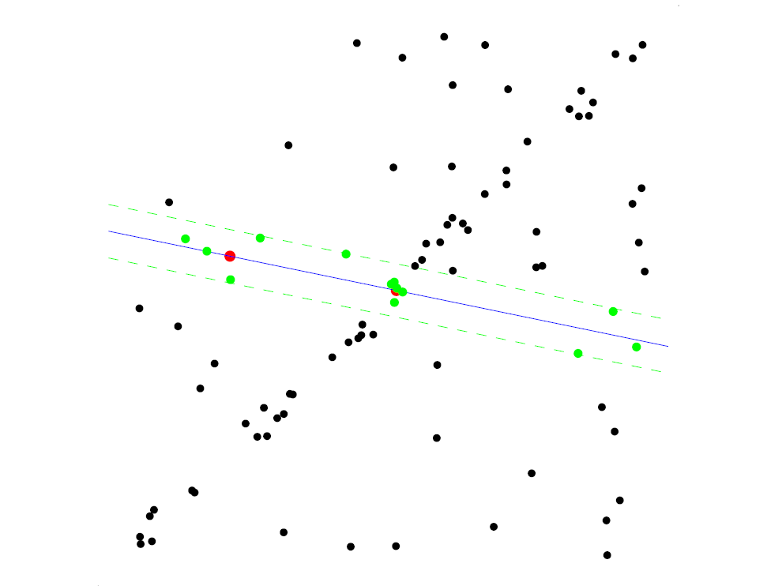
RANSAC for line fitting example
Randomly select minimal subset of points
Hypothesize a model
Compute error function
Select points consistent with model
Repeat hypothesize-and-verify loop
Source: R. Raguram

Slide 45
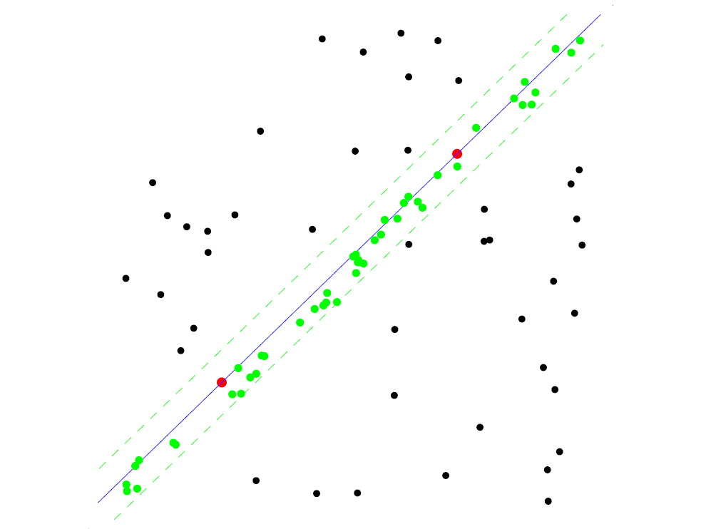
RANSAC for line fitting example
Uncontaminated sample
Randomly select minimal subset of points
Hypothesize a model
Compute error function
Select points consistent with model
Repeat hypothesize-and-verify loop
Source: R. Raguram

Slide 46
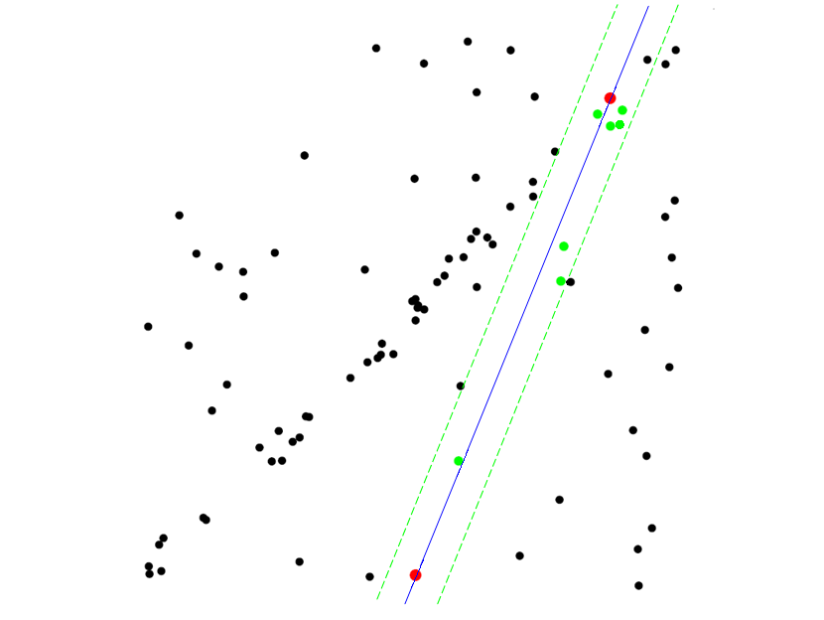
RANSAC for line fitting example
Randomly select minimal subset of points
Hypothesize a model
Compute error function
Select points consistent with model
Repeat hypothesize-and-verify loop
Source: R. Raguram
Notes:
46

Slide 47
RANSAC for line fitting
Repeat N times:
Draw s points uniformly at random
Fit line to these s points
Find inliers to this line among the remaining points (i.e., points whose distance from the line is less than t)
If there are d or more inliers, accept the line and refit using all inliers

Slide 48
Choosing the parameters
Initial number of points s
Typically minimum number needed to fit the model
Distance threshold t
Choose t so probability for inlier is p (e.g. 0.95)
Zero-mean Gaussian noise with std. dev. σ: t²=3.84σ²
Number of samples N
Choose N so that, with probability p, at least one random sample is free from outliers (e.g. p=0.99) (outlier ratio: e)
Source: M. Pollefeys

Slide 49
Choosing the parameters
Initial number of points s
Typically minimum number needed to fit the model
Distance threshold t
Choose t so probability for inlier is p (e.g. 0.95)
Zero-mean Gaussian noise with std. dev. σ: t²=3.84σ²
Number of iterations(samples) N
Choose N so that, with probability p, at least one random sample is free from outliers (e.g. p=0.99) (outlier ratio: e)
 | proportion of outliers e
s | 5% | 10% | 20% | 25% | 30% | 40% | 50%
2 | 2 | 3 | 5 | 6 | 7 | 11 | 17
3 | 3 | 4 | 7 | 9 | 11 | 19 | 35
4 | 3 | 5 | 9 | 13 | 17 | 34 | 72
5 | 4 | 6 | 12 | 17 | 26 | 57 | 146
6 | 4 | 7 | 16 | 24 | 37 | 97 | 293
7 | 4 | 8 | 20 | 33 | 54 | 163 | 588
8 | 5 | 9 | 26 | 44 | 78 | 272 | 1177
Source: M. Pollefeys

Slide 50
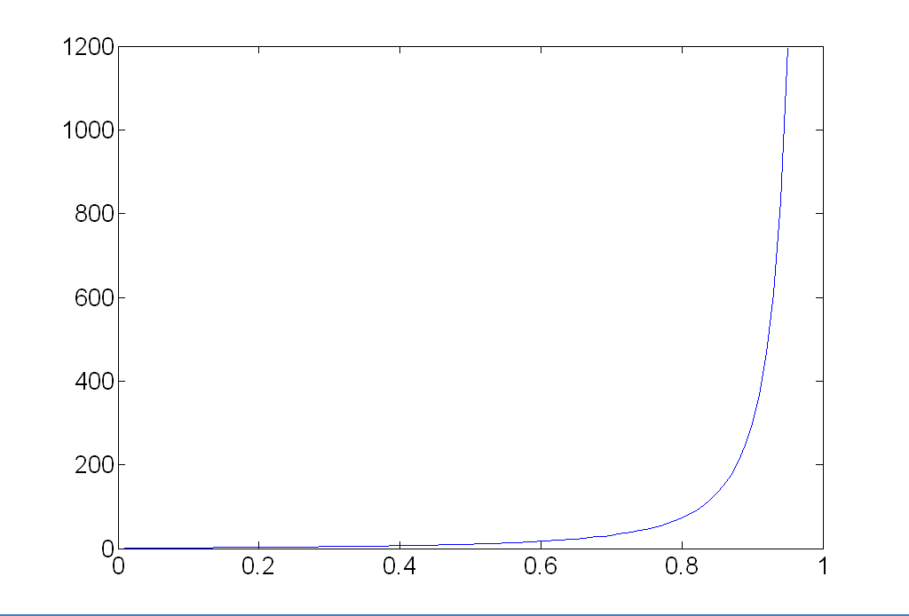
Choosing the parameters
Initial number of points s
Typically minimum number needed to fit the model
Distance threshold t
Choose t so probability for inlier is p (e.g. 0.95)
Zero-mean Gaussian noise with std. dev. σ: t²=3.84σ²
Number of samples N
Choose N so that, with probability p, at least one random sample is free from outliers (e.g. p=0.99) (outlier ratio: e)
Source: M. Pollefeys

Slide 51
Choosing the parameters
Initial number of points s
Typically minimum number needed to fit the model
Distance threshold t
Choose t so probability for inlier is p (e.g. 0.95)
Zero-mean Gaussian noise with std. dev. σ: t²=3.84σ²
Number of samples N
Choose N so that, with probability p, at least one random sample is free from outliers (e.g. p=0.99) (outlier ratio: e)
Consensus set size d
Should match expected inlier ratio
Source: M. Pollefeys

Slide 52
Adaptively determining the number of samples
Inlier ratio e is often unknown a priori, so pick worst case, e.g. 50%, and adapt if more inliers are found, e.g. 80% would yield e=0.2
Adaptive procedure:
N=∞, sample_count =0
While N >sample_count
Choose a sample and count the number of inliers
Set e = 1 – (number of inliers)/(total number of points)
Recompute N from e:
Increment the sample_count by 1
Source: M. Pollefeys

Slide 53
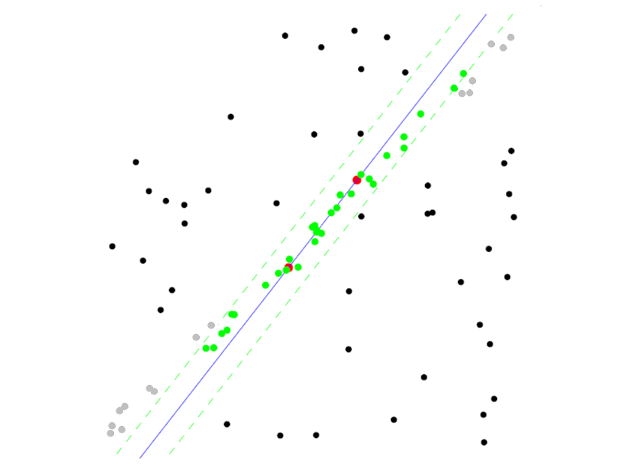
RANSAC pros and cons
Pros
Simple and general
Applicable to many different problems
Often works well in practice
Cons
Lots of parameters to tune
Doesn’t work well for low inlier ratios (too many iterations, or can fail completely)
Can’t always get a good initialization of the model based on the minimum number of samples

Slide 54
Matlab
http://www.mathworks.com/videos/feature-detection-extraction-and-matching-with-ransac-73589.html

Slide 55
Summary of Solutions
Least Squares Fit
closed form solution
robust to noise
not robust to outliers
Robust Least Squares
improves robustness to noise
requires iterative optimization
Hough transform
robust to noise and outliers
can fit multiple models
only works for a few parameters (1-4 typically)
RANSAC
robust to noise and outliers
works with a moderate number of parameters (e.g, 1-8)
Notes:
Iterative Closest Point (ICP)
For local alignment only: does not require initial correspondences

Slide 56
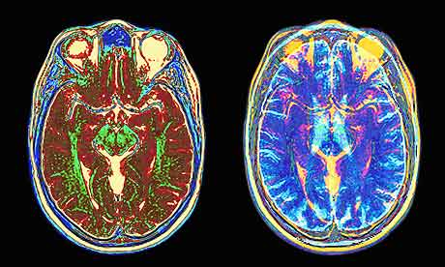
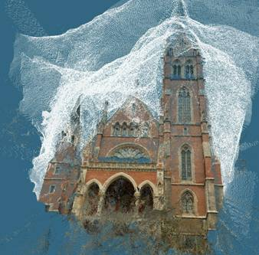
What if you want to align but have no prior matched pairs?
Hough transform and RANSAC not applicable
Important applications
Medical imaging: match brain scans or contours
Robotics: match point clouds

Slide 57
Iterative Closest Points (ICP) Algorithm
Goal: estimate transform between two dense sets of points
Initialize transformation (e.g., compute difference in means and scale)
Assign each point in {Set 1} to its nearest neighbor in {Set 2}
Estimate transformation parameters
e.g., least squares or robust least squares
Transform the points in {Set 1} using estimated parameters
Repeat steps 2-4 until change is very small

Slide 58
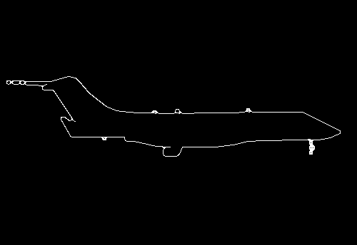
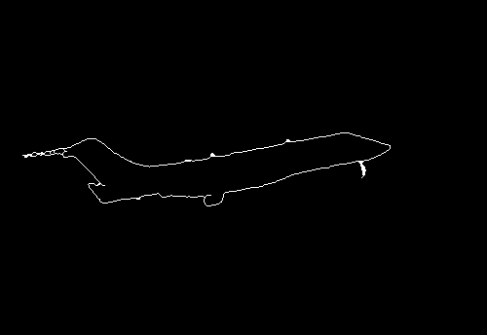
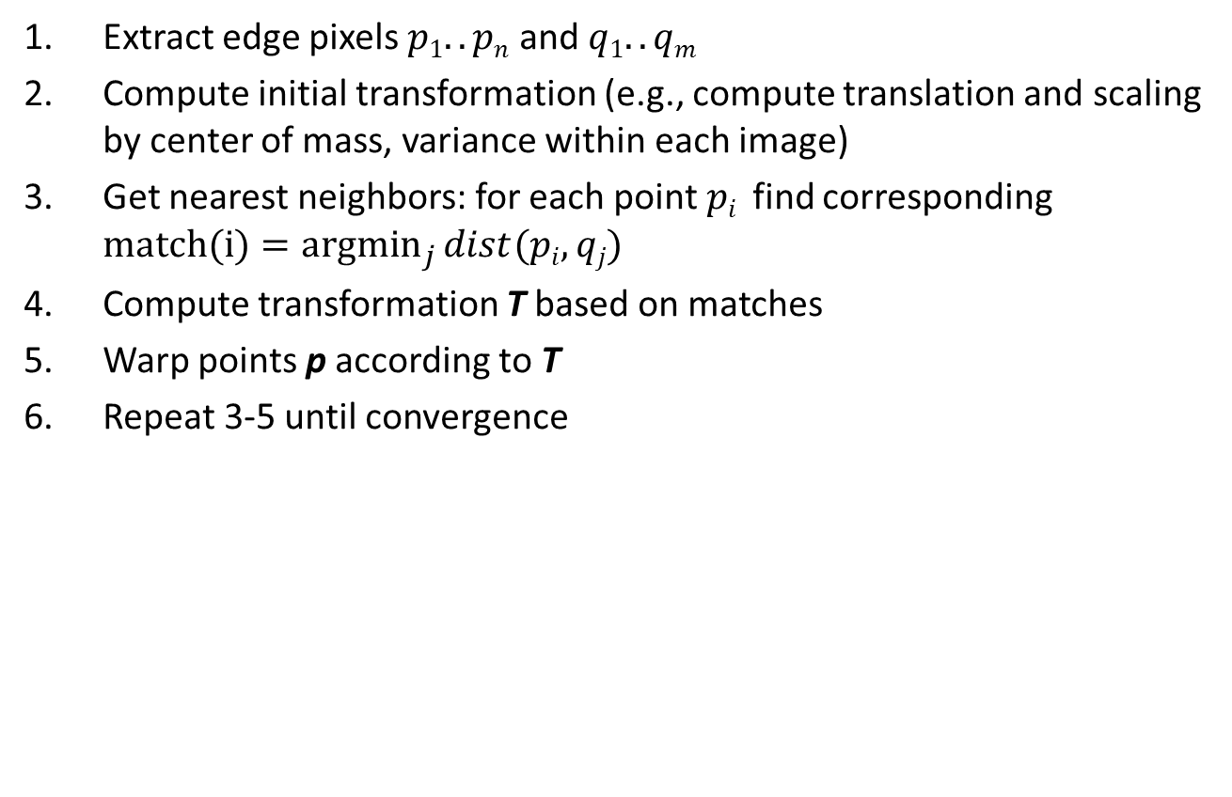
Example: aligning boundaries
Extract edge pixels $p1..pn$ and $q1..qm$
Compute initial transformation (e.g., compute translation and scaling by center of mass, variance within each image)
Get nearest neighbors: for each point $pi$ find corresponding $match(i)=\underset{j}{argmin}{dist(pi,qj)}$
Compute transformation T based on matches
Warp points p according to T
Repeat 3-5 until convergence
p
q

Slide 59
Example: solving for translation
(t_{x}, t_{y})
Problem: no initial guesses for correspondence
ICP solution
Find nearest neighbors for each point
Compute transform using matches
Move points using transform
Repeat steps 1-3 until convergence

Slide 60
So far
Most important techniques
Interest points/corners detection
Patch/image descriptors
Matching algorithms
A wide variety of applications
Recognition
…

Slide 61
Object Instance Recognition
Match keypoints to object model
Solve for affine transformation parameters
Score by inliers and choose solutions with score above threshold
A₁
B₃
A₃
A₂
Matched keypoints
B₁
B₂
Affine Parameters
This Class
# Inliers
Choose hypothesis with max score above threshold

Slide 63
Review
Fitting: find the parameters of a model that best fit the data
Alignment: find the parameters of the transformation that best align matched points

Slide 64
Review: Fitting and Alignment
Design challenges
Design a suitable goodness of fit measure
Similarity should reflect application goals
Encode robustness to outliers and noise
Design an optimization method
Avoid local optima
Find best parameters quickly

Slide 65

Overview of Keypoint Matching
1. Find a set of distinctive key- points
A₁
B₃
2. Define a region around each keypoint
A₂
A₃
B₁
B₂
3. Extract and normalize the region content
4. Compute a local descriptor from the normalized region
N pixels
e.g. color
e.g. color
N pixels
5. Match local descriptors

Slide 66
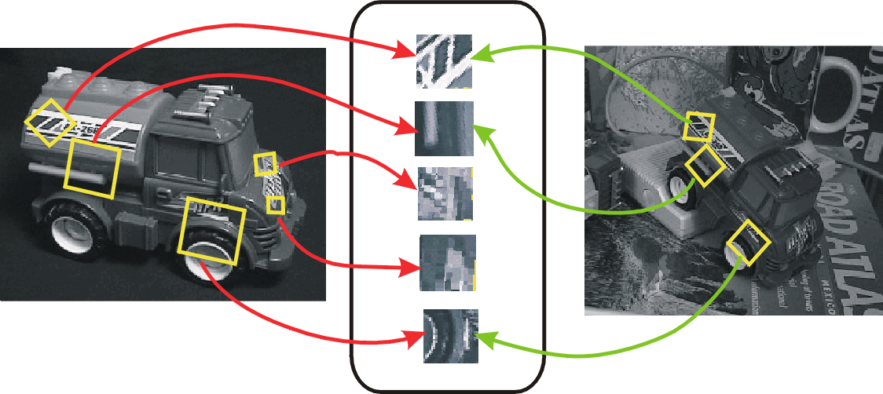
Keypoint-based instance recognition
Given two images and their keypoints (position, scale, orientation, descriptor)
Goal: Verify if they belong to a consistent configuration
Local Features, e.g. SIFT
Slide credit: David Lowe

Slide 67
Matching Keypoints
Want to match keypoints between:
Query image
Stored image containing the object
Given descriptor x₀, find two nearest neighbors x₁, x₂ with distances d₁, d₂
x₁ matches x₀ if d₁/d₂ < 0.8
This gets rid of 90% false matches, 5% of true matches in Lowe’s study

Slide 68
Affine Object Model
Accounts for 3D rotation of a surface under orthographic projection

Slide 69

Affine Object Model
Accounts for 3D rotation of a surface under orthographic projection
What is the minimum number of matched points that we need?

Slide 70
Finding the objects (overview)
Input Image
Stored Image
Match interest points from input image to database image
Matched points vote for rough position/orientation/scale of object
Find position/orientation/scales that have at least three votes
Compute affine registration and matches using iterative least squares with outlier check
Report object if there are at least T matched points

Slide 71
Finding the objects (SIFT, Lowe 2004)
Match interest points from input image to database image
Get location/scale/orientation using Hough voting
In training, each point has known position/scale/orientation wrt whole object
Matched points vote for the position, scale, and orientation of the entire object
Bins for x, y, scale, orientation
Wide bins (0.25 object length in position, 2x scale, 30 degrees orientation)
Vote for two closest bin centers in each direction (16 votes total)
Geometric verification
For each bin with at least 3 keypoints
Iterate between least squares fit and checking for inliers and outliers
Report object if > T inliers (T is typically 3, can be computed to match some probabilistic threshold)

Slide 72
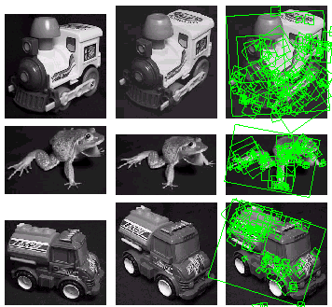
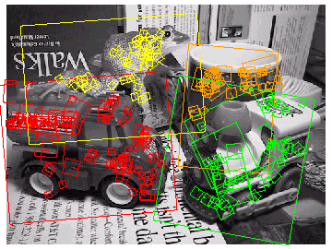
Examples of recognized objects

Slide 73
Example: solving for translation
A₁
A₅
B₄
A₂
A₃
(t_{x}, t_{y})
B₁
A₄
B₂
B₃
B₅
Problem: outliers
RANSAC solution
Sample a set of matching points (1 pair)
Solve for transformation parameters
Score parameters with number of inliers
Repeat steps 1-3 N times

